Slide 1
LECTURE 13 Finite-State Automata

Slide 2
What you will learn in this lecture:
Formal Language
Finite-State Automata

Slide 3
What is a Formal Language?
In English,
A word can be regarded as a string of letters, and
A sentence can be regarded as a string of words.
Computer languages are similar to English in that
Certain strings of characters are legitimate words of the language, and
Certain strings of words can be put together according to certain rules to form syntactically correct programs.
In computer science, it has proven useful to look at languages from a very abstract point of view as strings of certain fundamental units and allow any finite set of symbols to be used as an alphabet.
A formal language over an alphabet is any set of strings of characters of the alphabet. It is specified by a well-defined set of rules of syntax.
3
Notes:
An English sentence can be regarded as a string of words, and an English word can be regarded as a string of letters.
However, not every string of letters is a legitimate word, and not every string of words is a grammatical sentence.

Slide 4
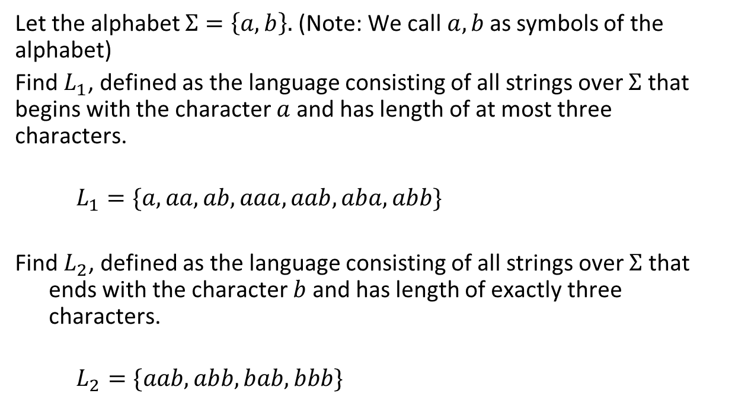
Example 1
Let the alphabet $Σ=\left\{a, b\right\}.$ (Note: We call$a, b$as symbols of the alphabet)
Find $L_{1}$, defined as the language consisting of all strings over $Σ$ that begins with the character $a$ and has length of at most three characters.
$$L_{1}=\{a, aa, ab, aaa, aab, aba, abb\}$$
Find $L_{2}$, defined as the language consisting of all strings over $Σ$ that ends with the character $b$ and has length of exactly three characters.
$$L_{2}=\{aab, abb, bab, bbb\}$$
Notes:
An English sentence can be regarded as a string of words, and an English word can be regarded as a string of letters.
However, not every string of letters is a legitimate word, and not every string of words is a grammatical sentence.

Slide 5
Example 1
Let the alphabet $Σ=\left\{a, b\right\}.$ (Note: We call$a, b$as symbols of the alphabet)
Find $L_{1}$, defined as the language consisting of all strings over $Σ$ that begins with the character $a$ and has length of at most three characters.
$$L_{1}=\{a, aa, ab, aaa, aab, aba, abb\}$$
Find $L_{2}$, defined as the language consisting of all strings over $Σ$ that ends with the character $b$ and has length of exactly three characters.
$$L_{2}=\{aab, abb, bab, bbb\}$$
Notes:
An English sentence can be regarded as a string of words, and an English word can be regarded as a string of letters.
However, not every string of letters is a legitimate word, and not every string of words is a grammatical sentence.

Slide 6
What is a Finite-State Automaton?
A finite-state automaton is an idealized machine that embodies the essential idea of a sequential circuit, where the output depends not only on the input, but also on the state of the system when the input is received.
Each piece of input to a finite-state automaton leads to a change in the state of the automaton, which in turn affects how subsequent input is processed.
An example is the act of dialing a telephone number. Dialing 1–300 puts the telephone circuit in a state of readiness to receive the final seven digits of a toll-free call, whereas dialing 013 leads to a state of expectation for the other seven digits of a mobile call.
6

Slide 7

Definition of a Finite-State Automaton
A finite-state automaton consists of five objects:
A finite set of states, $S=\{s0, s1, … , sn\}$;
An initial state, normally denoted by $s0$;
A set of accepting states, $A⊆S.$
A finite set of input symbols, $I$;
A next-state function, $f:S ×I→S$that assigns a next state to every pair of state and input.
a, b
b
a
s₀
d
s₁
a
s₂
d
b, d
This is known as a state-transition diagram.
7

Slide 8
Example 2
a, b
b
a
s₀
d
s₁
a
s₂
d
b, d
The finite-state automaton above is defined as M = {S, s₀, A, I, F}, where
S = {s₀, s₁, s₂}
A = {s₂ }
I = {a, b, d}
F = {f_{x} | x ∈ I}
The initial state is indicated by an incoming arrow;
The accepting state is marked by a double circle.
8

Slide 9
Next-State Table
State | Input
 | a | b | d
s₀ | s₀ | s₀ | s₁
s₁ | s₂ | s₁ | s₀
s₂ | s₂ | s₁ | s₁
A next-state table shows the values of the next-state function f for all possible states s and input symbols i.
Next states
a, b
b
a
s₀
d
s₁
a
s₂
d
b, d
9

Slide 10
Example 3
Which state the automaton will be in when:
It receives input a at initial time?
It receives input b at s₁?
It receives input add at s₂?
State | Input
 | a | b | d
s₀ | s₀ | s₀ | s₁
s₁ | s₂ | s₁ | s₀
s₂ | s₂ | s₁ | s₁
a, b
b
a
s₀
d
s₁
a
s₂
d
b, d
10

Slide 11
Formal Language and Finite-State Automata
A compiler for a computer language analyzes the stream of characters in a program by:
Firstly, recognizing individual word and sentence units.
Secondly, analyzing the syntax, or grammar, of the sentences.
Finally, translating the sentences into machine code.
Regular languages, which are defined by regular expressions, are used extensively for matching patterns within text and for lexical analysis in computer language compilers.
Regular expressions of a formal language make it possible to replace a long, complicated set of if-then-else statements with code that is easy both to produce and to understand.
According to Kleene’s Theorem, the set of languages defined by regular expressions is identical to the set of languages accepted by finite-state automata.
11
Notes:
An English sentence can be regarded as a string of words, and an English word can be regarded as a string of letters.
However, not every string of letters is a legitimate word, and not every string of words is a grammatical sentence.

Slide 12
Defining Language by a Regular Expression
Regular expression is one of the most useful ways to define a language. The following describes ways in which language can be formed by regular expression:
Let Σ be an alphabet, with a and b as symbols/strings for regular expressions over Σ, the following are also regular expressions over Σ:
Regular Expressions | Meaning
(ab) | Concatenation of a and b
(a | b) | Either one of a or b
(a*) | Concatenation of a with itself any finite number (including zero) of times

Slide 13
What is a Language Accepted by an Automaton?
Suppose a string of input symbols is fed into a finite-state automaton in sequence. At the end of the process, after each successive input symbol has changed the state of the automaton, the automaton ends up in a certain state, which may be either an accepting state or a non-accepting state.
Those strings that send the automaton to an accepting state are said to be accepted by the automaton.
The language accepted by the automaton M, denoted as L(M), is the set of all strings that are accepted by M.
13

Slide 14
Example 4
Remember that an accepting state is
indicated by the double circle.
a, b
b
a
s₀
d
s₁
a
s₂
d
b, d
This finite-state automaton accepts the strings of inputs that stops at s_{2.}
The automaton accepts the following inputs:
da ada bda aaaaaaabbbbbdabbbbbbaaaaa
dba adba bdba bbbbbbbaaaaaaaadaaaaaaaaa
abda bada daaaaaaaaaaaaaaaaaaaaaaaaaaaaaaaa
The automaton does not accept the following inputs:
abbba adbb bbabd aababddbab
abdda dbab bdbdd bdbdaaadb
abdddbaab badbaabbabbadb
14

Slide 15
Example 5
a
a
s₀
b
s₁
s₂
s₀
s₀
b
s₃
a, b
a, b
Given the finite-state automaton M as shown above,
Give three strings that are accepted by M.
Give three strings that are not accepted by M.
What is the language accepted by the M?
Solution:
a, aaba, abab
abb, bbbb, bbaab
L(M) = {a^{k}, a^{n}bax where k ∈ Z⁺ , n ∈ N, and x is any string of a’s and b’s}.
= {a* | a* ba(a|b)*}
15

Slide 16
Example 6
a
a
a, b
s₀
b
s₁
b
s₂
s₂
Given the finite-state automaton M as shown above,
Give three strings that are accepted by M.
Give three strings that are not accepted by M.
What is the language accepted by the M?
Solution:
bb, abab, babaab
aa, abaa, aaabaa
L(M) = The set of strings that contain at least two b’s.
= {a^{n}ba^{n}bx where n ∈ N and x is any string of a’s and b’s}.
= {a*ba*b(a|b)*}

Slide 17
Summary
You have learned the following concepts related to finite-state automata:
The meaning of finite-state automata
The link between finite-state automata and formal language
Recognizing the language accepted by a finite-state automaton
17

Slide 18
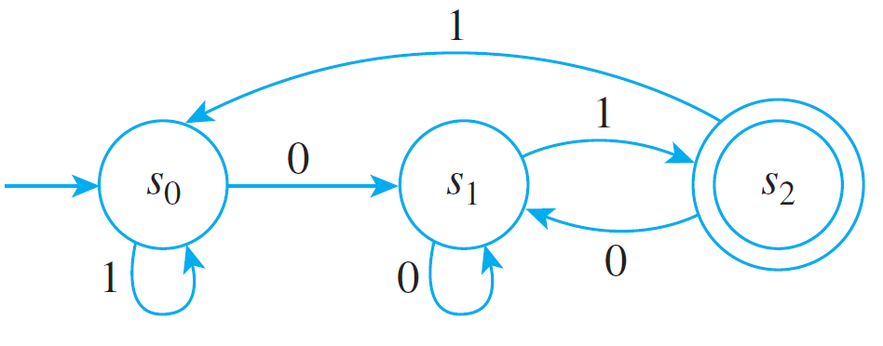
Self Test 1
Given the following finite-state automaton, M:
Find its
States.
Input symbols.
Initial state.
Accepting state(s).
Construct the next-state table for M.
To what states does M go if the symbols of the following strings are input to M in sequence, starting from the initial state?
(i) 01 (ii) 0011 (iii) 0101100 (iv) 10101
Which of the strings in part (c) send M to an accepting state?
What is the language accepted by M?
18

